Slide 1

Parish-Wide Fundraising
A Guide for Parish Staff
Resources to help you communicate, educate, and invite participation in your parish endowment

Slide 2
Purpose of the Toolkit
This toolkit was created to help with parish-wide fundraising so that you can:
Communicate clearly about your parish endowment
Share your parish story and mission
Educate parishioners about stewardship and legacy giving
Provide consistent messaging across platforms
Make implementation simple and flexible
Build long-term support for your parish mission
You can use as much or as little of the toolkit as fits your parish.

Slide 3

How to Use This Toolkit
Watch our video for a brief overview of:
What’s included in the toolkit
How to use each asset
Suggested communication timeline
Where to start
https://youtu.be/_TJIxiW5H3w

Slide 4
What’s included
Internal Planning Resources
Resources available online:
Endowment Project Timeline
Case Statement Worksheet
Other promotion ideas
Information for your parish staff, found in this presentation
Editorial Calendar
Instructions for using the assets
External Communication Resources:
Information to be distributed across your communications channels
Bulletin Inserts (full page insert + short blurbs for regular mentions)
Long-form content, including a pastor letter (for your website or bulletin)
Social media posts (for Facebook and/or Instagram)
Posters (1 and 2)
Monitor slides (1 and 2)
Pulpit announcement for launch week
All materials are editable and customizable for your parish.

Slide 5
START HERE:
Begin With Your
Case Statement
Reminder: This resource is focused on communications and should not replace leadership planning and legal documentation. See toolkit booklet for planning guidance.

Slide 6

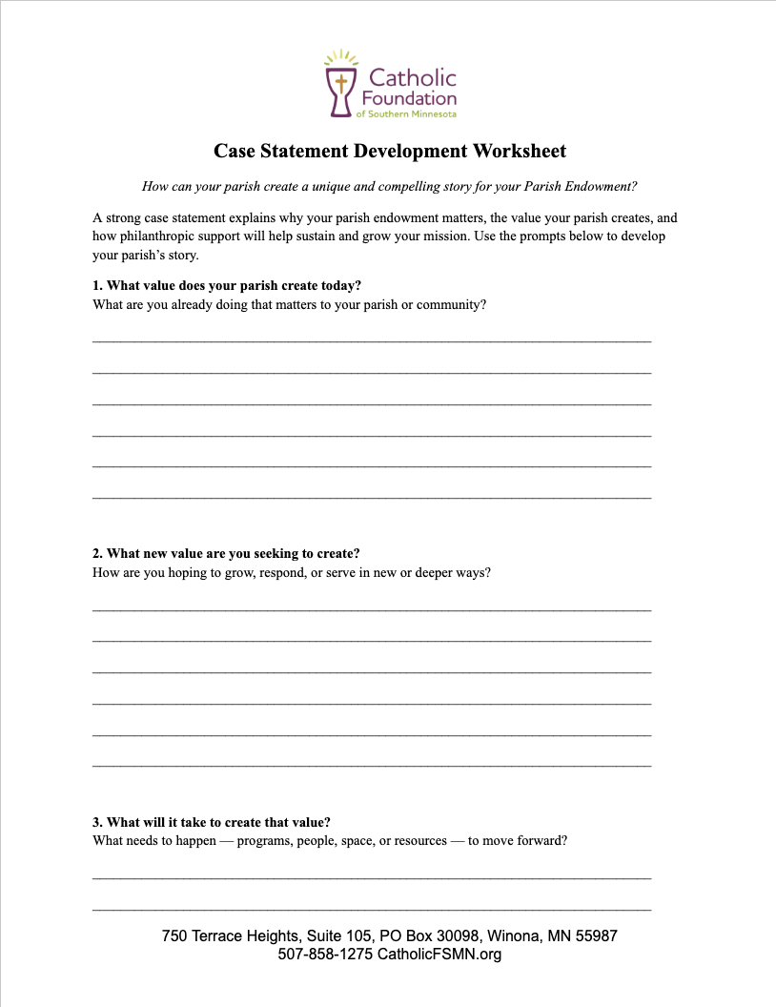

Step 1: Start with Your Parish Story
Before communicating with your parishioners, identify:
Use the Case Statement Worksheet to develop:
What your parish already does well
What you hope to do with this endowment? What value will it have?
What will it take to create this additional value?
How can parishioners participate?
Your parish mission message, goals, needs, and invitation
Fill out your case statement
Need help? Contact your Catholic Foundation representative.

Slide 7
STEP 2:
Plan Your Communications

Slide 8
Step 2: Use the Editorial Calendar
Choose a cadence that fits your parish.
Communications Channels to Use:
You can use toolkit materials across:
Parish bulletin (Short inserts + full page)
Website (blogs)
Email newsletters
Social media
Pulpit announcements
Digital monitors
Posters in parish spaces
Direct mailings
Spread messaging throughout the year
Avoid overwhelming parishioners
Reinforce stewardship themes
Rotate communication channels
Use the template on the following slides to edit to your parish needs

Slide 9
Editorial Calendar (Example)
Summer (June – August)
(Launch) Easter Season (April – May)
Short Bulletin Insert (#2)
Short Bulletin Insert (#3)
Social Post (#2)
Continue with Monitor Graphic (#1)
Post Poster around parish
Full Bulletin Insert or Short bulletin Insert (#1)
Post Blog (#1): Stewardship on Website
Monitor Graphic (#1)
Social Post (#1)
Pulpit Announcement at weekend masses

Slide 10
Editorial Calendar (Example)
Fall (Sept. – Nov.)
Advent (Dec. – Jan.)
Short Bulletin Insert (#4)
Short Bulletin Insert (#5)
Post Blog (#2): Pastoral Letter on website
Rotate Monitor Graphic (#2)
Short Bulletin Insert (#6)
Short Bulletin Insert (#7)
Social Post (#3)
Lent (Feb. – March)
Short Bulletin Insert (#8)

Slide 11
INSTRUCTIONS:
How to Use The Assets

Slide 12
Each Toolkit Item is Customizable
Asset | Customization | Instructions
Parish Bulletin: Full Page Insert | Customize with your parish name and contact info | Export PowerPoint slide as a .PDF for printing
Parish Bulletin: Copy for year-round | Customize with your parish name and contact info | Copy and paste into your digital and printed bulletin for year-round messaging
Blogs (x2): Stewardship and Pastor Letter | Customize with your parish name and contact info | Publish to your website or bulletin; Consider mailing the pastor letter
Pulpit Announcement | Customize with your parish name and contact info | Select a weekend for it to be read at each mass during announcements.
Posters for printing | Customize with your parish name and contact info | Export PowerPoint slide as a .PDF for printing and put it around your parish
Social Media Posts | Customize copy with your parish name and contact info | Copy and paste the captions for Facebook and Instagram and download the provided assets for images.
Monitor Graphics | Customize copy with your parish name and contact info | Add to your rotating monitor announcements

Slide 13
Need Help?
The Catholic Foundation Is Here to Support You.
We can assist with:
Case statement development
Communication planning
Custom messaging
Presentation support
Stewardship education
Donor conversations
Contact:
Elizabeth Williams, Executive Director
info@catholicfsmn.org
507-218-4098

Slide 14
Thank you!
Your work and sacrifice today will solidify our Catholic parishes for generations to come

